Slide 1
Software Project Scheduling
Introduction
Project scheduling
Task network
Timeline chart
Earned value analysis

Slide 2
Introduction

Slide 3
Objectives of Planning and Scheduling
Develop the necessary understanding and skills to produce and manage a simple project schedule.

Slide 4
Project Planning and Scheduling
So far we have a project for which we have estimated duration and effort based on a high level understanding of what needs to be done.
The majority of projects are 'completed' late, if at all.
A project schedule is required to ensure that required project commitments are met.
A schedule is required to track progress toward achieving these commitments.

Slide 5
Why Software Is Delivered Late?

Slide 6
Eight Reasons for Late Software Delivery
An unrealistic deadline established by someone outside the software engineering group and forced on managers and practitioners within the group
Changing customer requirements that are not reflected in schedule changes
An honest underestimate of the amount of effort and /or the number of resources that will be required to do the job
Predictable and/or unpredictable risks that were not considered when the project commenced
Technical difficulties that could not have been foreseen in advance
Human difficulties that could not have been foreseen in advance
Miscommunication among project staff that results in delays
A failure by project management to recognize that the project is falling behind schedule and a lack of action to correct the problem

Slide 7
Project Planning and Scheduling

Slide 8
“One day a time”
All technical projects involve 100s of small tasks
Some tasks do no affect the project completion
Other tasks are critical for project completion
Project manager must:
  define all project tasks
  build a network that depicts their interdependence
  identify the critical tasks
  track the progress of these tasks
  recognize the delay “one day at a time”

Slide 9
Two different Perspectives to view Scheduling
End date for completion has been finalized
Only Rough time-frame is given
  In the second view, assume that rough chronological bounds have been discussed but that the end-date is set by the software engineering organization
  In the first view, an end-date for release of a computer-based system has already been established and fixed

Slide 10
Basic Principles for SE Scheduling
Compartmentalization – define distinct tasks
Interdependency- parallel and sequential tasks
Time allocation - assigned person days, start time, ending time)
Effort validation - be sure resources are available
Defined responsibilities — people must be assigned
Defined Outcomes- each task must have an output
Defined milestones - review for quality

Slide 11
People and Effort
“If we fall behind schedule we can always add more programmers and catch to late in the project”
Has a disruptive effect on the project
Schedules slip even further

Slide 12
People and Effort
The relationship between the number of people working in software project and overall productivity is
not linear
Fewer people and longer time period is a better option for software development

Slide 13
Effort Applied vs. Delivery Time
There is a nonlinear relationship between effort applied and delivery time (Ref: Putnam-Norden-Rayleigh Curve)‏
  Effort increases rapidly as the delivery time is reduced
Also, delaying project delivery can reduce costs significantly as shown in the equation E = L³/(P³t⁴) and in the curve below
  E = development effort in person-months
  L = source lines of code delivered
  P = productivity parameter (ranging from 2000 to 12000)‏
  t = project duration in calendar months
Effort
cost
Impossible
region
E _{theoretical}
E _{optimal}
t _{minimum}
t _{theoretical}
t _{optimal}
Development time

Slide 14
Effort Distribution
40-20-40
Front-end Analysis & Design
Back-end testing
Coding

Slide 15
40-20-40 Distribution of Effort (continued)‏
Example: 100-day project
6/1
6/4
6/23
7/14
8/2
9/5
P
Analysis
Design
Coding
Testing
40
20
40

Slide 16
Effort Allocation
“front end” activities
  customer communication
  analysis
  design
  review and modification
construction activities
  coding or code generation
testing and installation
  unit, integration
  white-box, black box
  regression
40-50%
15-20%
30-40%

Slide 17
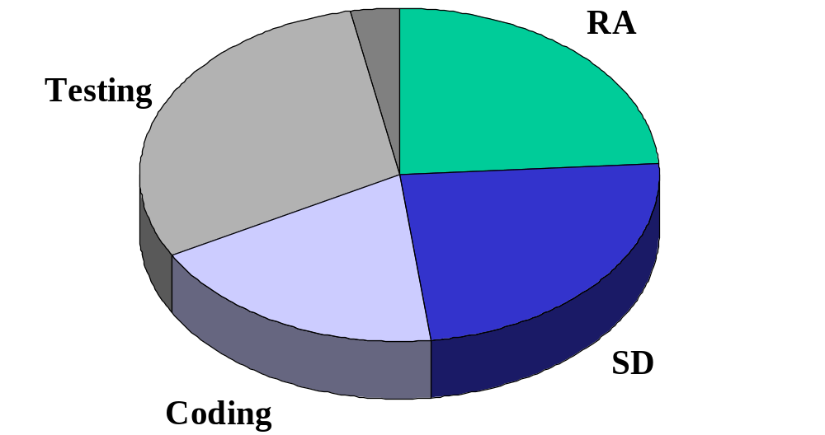
Effort Distribution
(2-3%)
(20-25%)
(30 - 40%)
(20-25%)
(15 -20%)

Slide 18
Task Network

Slide 19
Defining a Task Set
A task set is the work breakdown structure for the project
No single task set is appropriate for all projects and process models
  It varies depending on the project type and the degree of rigor (based on influential factors) with which the team plans to work
The task set should provide enough discipline to achieve high software quality
  But it must not burden the project team with unnecessary work

Slide 20
Scheduling and Planning
In order to make a schedule, the following tasks must be completed:
  Identify manageable activities and tasks by decomposing the process and the product.
  Determine which tasks are dependent on the completion of others. (Which activities must occur in sequence and which can occur concurrently.)
  Allocate each task a number of work-units (often person-days), a start date and a completion date.
  Define responsibilities for the tasks (allocate them to a person or persons).
  Define outcomes of the tasks (deliverables) and milestones for the schedule.
  Review the proposed tasks, their effort allocation and start and end dates with the people involved to ensure there are no conflicts and over allocation.

Slide 21
Identifying Tasks
The first step :
identify the tasks required to be performed.
These tasks will comprise software engineering activities broken down for product functions.
A schedule is not a fixed entity and as such it will be refined as a project progresses.
  Initially rough
  a project schedule usually refers to the work tasks, deliverables and milestones for major software engineering activities and major product functions
  is refined in detail
  as the project progresses to refer to specific tasks and activities that must be completed for those major activities and functions.

Slide 22
Selecting Project Tasks
No set of tasks is appropriate for all projects.
The set of tasks that are appropriate for a project depends on a number of factors. These include:
  The process model selected. An iterative development model would require different tasks, etc... than would a waterfall model or rapid application development model.
  The type of project. A new development project has a different set of tasks to a maintenance project or to a concept development.
  The size and complexity of the product.
  The rigor required in development. This is a factor generally determined by things like product size, mission criticality, stability of requirements, etc...

Slide 23
Selecting Project Tasks
Many software engineering tasks have deliverables.
For example, the Software Requirements Specification (SRS) might be the deliverable produced as a result of requirements analysis.
Milestones are objectively identifiable points in a project. They are generally associated with the completion of a major activity. It is often a good idea to associate them with deliverables.
For example, a milestone might be established at initial requirements sign-off. This checkpoint will come after the requirements documents have been produced, inspected, corrected and signed off on. The only rule for establishing a checkpoint is that you must be able to objectively determine if that milestone has been reached.

Slide 24
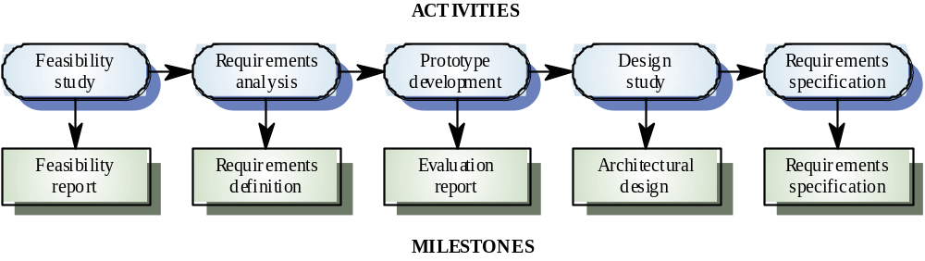
Selecting Project Tasks
  Milestone = end-point of a specific, distinct software process activity or task (for each milestone a report should be presented to the management)
  Deliverable = project result delivered to the client
  In order to establish milestones the phases of the software process phases need be divided in basic activities/tasks.

Slide 25
Defining Task Sets
determine type of project
assess the degree of rigor required
  identify adaptation criteria
  compute task set selector (TSS) value
  interpret TSS to determine degree of rigor
select appropriate software engineering tasks

Slide 26
Software Project Types
Concept Development projects
New Application Development Projects
Application Enhancement Project
Application Maintenance Project
Reengineering Project

Slide 27
Types of Software Projects
Concept development projects
  Explore some new business concept or application of some new technology
New application development
  Undertaken as a consequence of a specific customer request
Application enhancement
  Occur when existing software undergoes major modifications to function, performance, or interfaces that are observable by the end user
Application maintenance
  Correct, adapt, or extend existing software in ways that may not be immediately obvious to the end user
Reengineering projects
  Undertaken with the intent of rebuilding an existing (legacy) system in whole or in part

Slide 28
Degree of Rigor
Casual
Minimum task set is required
Umbrella tasks are minimized
Documentation requirements are reduced
Basic principles of SE are applicable
Structured
Framework activities will be applied
Umbrella tasks are applied
Documentation and measurement tasks will be done in a streamlines manner
Strict
Full process will be applied
Degree of discipline ensures high quality
All umbrella activities will be applied
Robust work products will be produced
Quick Reaction
Process framework will be applied
Only essential tasks will be undertaken
Documentation will be provided after product delivery

Slide 29
Factors that Influence a Project’s Schedule
Size of the project
Number of potential users
Mission criticality
Application longevity
Stability of requirements
Ease of customer/developer communication
Maturity of applicable technology
Performance constraints
Embedded and non-embedded characteristics
Project staff
Reengineering factors

Slide 30
Task Set selector
Based on adaptation criteria, TSS is computed
Casual
TSS > 1.2
Structured
1.0 < TSS < 3.0
Strict
TSS > 2.4

Slide 31
Purpose of a Task Network
Also called an activity network
It is a graphic representation of the task flow for a project
It depicts task length, sequence, concurrency, and dependency
Points out inter-task dependencies to help the manager ensure continuous progress toward project completion
The critical path
  A single path leading from start to finish in a task network
  It contains the sequence of tasks that must be completed on schedule if the project as a whole is to be completed on schedule
  It also determines the minimum duration of the project

Slide 32
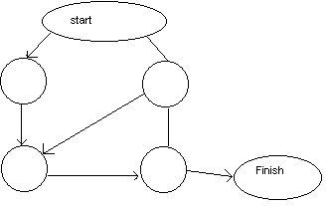
Activity Graph
Each activity has:
Precursor
Duration
Due date
End point (milestone or deliverable)

Slide 33
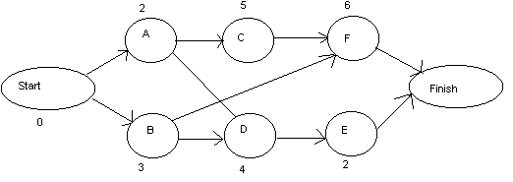
CPM
Critical Path Method

Slide 34
Activity
Precursor
Duration
EST
EFT
LST
LFT
Slack
Start
-
0
0
0
0
0
0
A
Start
2
0
2
0
2
0
B
Start
3
0
3
4
7
4
C
A
5
2
7
2
7
0
D
A,B
4
3
7
7
11
4
E
D
2
7
9
11
13
4
F
B,C
6
7
13
7
13
0
FINISH
E,F
0
13
13
13
13
0
EST = earliest start time, EFT = earliest finish time.
LST = latest start time, LFT = latest finish time.
Slack = (LST - EST) or (LFT - EFT).

Slide 35
CPM Equations
EST(START) always = 0, EFT(START) always = 0.
LST(START) always = 0, LFT(START) always = 0.
EFT(I) = EST(I) + DUR(I).
EST(I) = max(EFT of all predecessors).
LST(I) = LFT(I) - DUR(I).
LFT(I) = min(LST of all sucessors).
LFT(FINISH) = LST(FINISH) = EST(FINISH) = EFT(FINISH).
Critical path is all nodes with Slack = 0.

Slide 36
Task Set Refinement
1.1 Concept scoping determines the overall scope of the project.
Task definition: Task 1.1 Concept Scoping
1.1.1 Identify need, benefits and potential customers;
1.1.2 Define desired output/control and input events that drive the application;
Begin Task 1.1.2
1.1.2.1 FTR: Review written description of need
  FTR indicates that a formal technical review (Chapter 26) is to be conducted.
1.1.2.2 Derive a list of customer visible outputs/inputs
1.1.2.3 FTR: Review outputs/inputs with customer and revise as required;
endtask Task 1.1.2
is refined to

Slide 37
Task Set Refinement
1.1 Concept scoping determines the overall scope of the project.
1.1.3 Define the functionality/behavior for each major function;
Begin Task 1.1.3
1.1.3.1 FTR: Review output and input data objects derived in task 1.1.2;
1.1.3.2 Derive a model of functions/behaviors;
1.1.3.3 FTR: Review functions/behaviors with customer and revise as required;
endtask Task 1.1.3
1.1.4 Isolate those elements of the technology to be implemented in software;
1.1.5 Research availability of existing software;
1.1.6 Define technical feasibility;
1.1.7 Make quick estimate of size;
1.1.8 Create a Scope Definition;
endTask definition: Task 1.1
is refined to

Slide 38
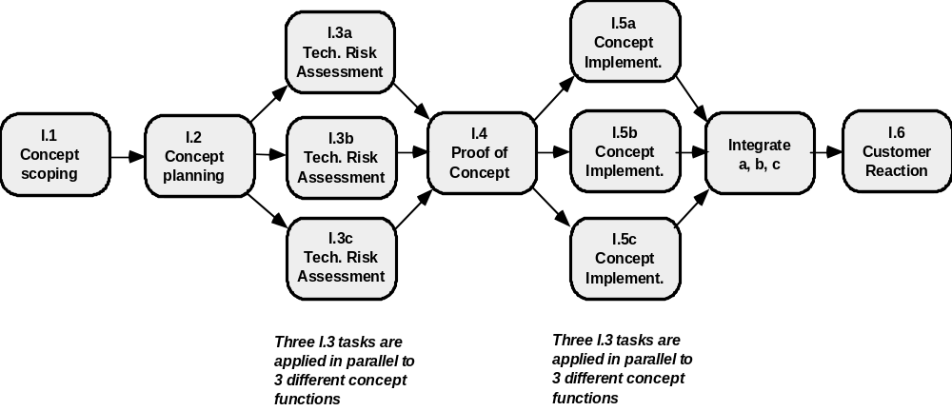
Define a Task Network

Slide 39
Example Task Network
Task F
2
Task G
3
Task H
5
Task B
3
Task N
2
Task A
3
Task C
7
Task E
8
Task I
4
Task J
5
Task M
0
Task D
5
Task K
3
Task L
10
Where is the critical path and what tasks are on it?

Slide 40
Example Task Network with Critical Path Marked
Task F
2
Task G
3
Task H
5
Task B
3
Task N
2
Task A
3
Task C
7
Task E
8
Task I
4
Task J
5
Task M
0
Task D
5
Task K
3
Task L
10
Critical path: A-B-C-E-K-L-M-N

Slide 41
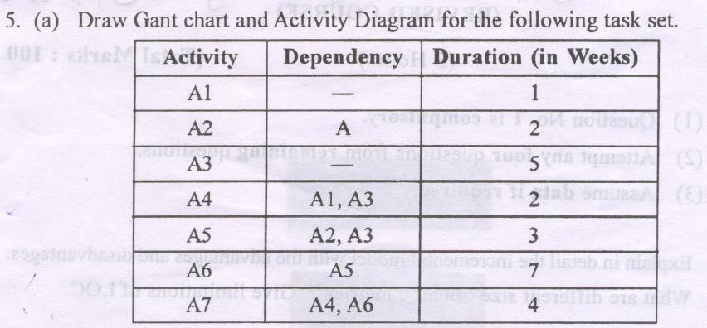
University Questions

Slide 42
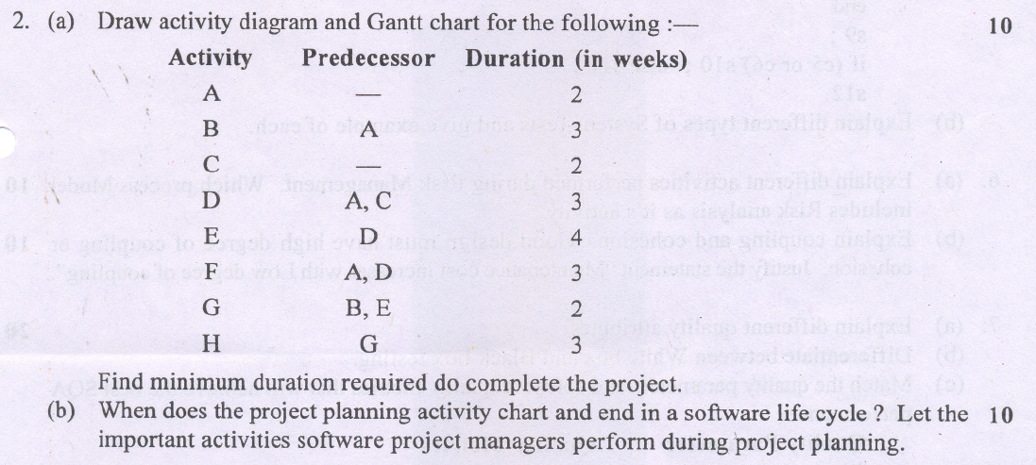
University Questions

Slide 43
Timeline Chart

Slide 44
Mechanics of a Timeline Chart
Also called a Gantt chart; invented by Henry Gantt, industrial engineer, 1917
All project tasks are listed in the far left column
The next few columns may list the following for each task: projected start date, projected stop date, projected duration, actual start date, actual stop date, actual duration, task inter-dependencies (i.e., predecessors)‏
To the far right are columns representing dates on a calendar
The length of a horizontal bar on the calendar indicates the duration of the task
When multiple bars occur at the same time interval on the calendar, this implies task concurrency
A diamond in the calendar area of a specific task indicates that the task is a milestone; a milestone has a time duration of zero
Jan Feb Mar Apr May Jun Jul Aug Sep Oct
Task #
Task Name
Duration
Start
Finish
Pred.
1
Task A
2 months
1/1
2/28
None
2
Milestone N
0
3/1
3/1
1

Slide 45
CLASS EXERCISE
Timeline chart:
4/1 4/8 4/15 4/22 4/29 5/6 5/13 5/20 5/27 6/3
Task #
Task Name
Duration
Start
Finish
Pred.
A
Establish increments
3
4/1
None
B
Analyze Inc One
3
A
C
Design Inc One
8
B
D
Code Inc One
7
C
E
Test Inc One
10
D
F
Install Inc One
5
E
G
Analyze Inc Two
7
A, B
H
Design Inc Two
5
G
I
Code Inc Two
4
H
J
Test Inc Two
6
E, I
K
Install Inc Two
2
J
L
Close out project
2
F, K
Task network and the critical path:

Slide 46
SOLUTION
Timeline chart:
4/1 4/8 4/15 4/22 4/29 5/6 5/13 5/20 5/27 6/3
Task #
Task Name
Duration
Start
Finish
Pred.
A
Establish increments
3
4/1
4/3
None
B
Analyze Inc One
3
4/4
4/6
A
C
Design Inc One
8
4/7
4/14
B
D
Code Inc One
7
4/15
4/21
C
E
Test Inc One
10
4/22
5/1
D
F
Install Inc One
5
5/2
5/6
E
G
Analyze Inc Two
7
4/7
4/13
A, B
H
Design Inc Two
5
4/14
4/18
G
I
Code Inc Two
4
4/19
4/22
H
J
Test Inc Two
6
5/2
5/7
E, I
K
Install Inc Two
2
5/8
5/9
J
L
Close out project
2
5/10
5/11
F, K
Task network and the critical path:
A-B-C-D-E-J-K-L
B. Analyze
Inc One
3
C. Design
Inc One
8
D. Code
Inc One
7
E. Test
Inc One
10
F. Install
Inc One
5
A. Establish
Increments
3
L. Close out
Project
2
G. Analyze
Inc Two
7
H. Design
Inc Two
5
I. Code
Inc Two
4
J. Test
Inc Two
6
K. Install
Inc Two
2

Slide 47
Proposed Tasks for a Long-Distance Move of 8,000 lbs of Household Goods
Pack
household
goods
Arrange for
workers to
unload truck
Make
decision
to move
Determine
destination
location
Determine
date to move
out or move in
Make
lodging
reservations
Reserve
rental truck
and supplies
Get money
to pay for
the move
Drive truck
from origin
to destination
Find lodging
with space
to park truck
Plan travel
route and
overnight stops
Lease or buy
home at
destination
Decide on
type/size of
rental truck
Return
truck and
supplies
Load
truck
Arrange for
person to
drive truck/car
Pick up
rental truck
Unload
truck
Arrange for
workers to
load truck
Where is the critical path and what tasks are on it?
Given a firm start date, on what date will the project be completed?
Given a firm stop date, when is the latest date that the project must start by?

Slide 48
Task Network for a Long-Distance Move of 8,000 lbs of Household Goods
2. Get money
to pay for
the move
3. Determine
date to move
out or move in
4. Determine
destination
location
12. Plan travel
route and
overnight stops
13. Find lodging
with space
to park truck
14. Make
lodging
reservations
5. Lease or buy
home at
destination
1. Make
decision
to move
6. Decide on
type/size of
rental truck
11. Milestone
18. Drive truck
from origin
to destination
19. Unload
truck
7. Arrange for
workers to
load truck
15. Reserve
rental truck
and supplies
16. Pick up
rental truck
17. Load
truck
8. Arrange for
person to
drive truck/car
20. Return
truck and
supplies
9. Arrange for
workers to
unload truck
Where is the critical path and what tasks are on it?
Given a firm start date, on what date will
the project be completed?
Given a firm stop date, when is the latest date
that the project must start by?
10. Pack
household
goods

Slide 49
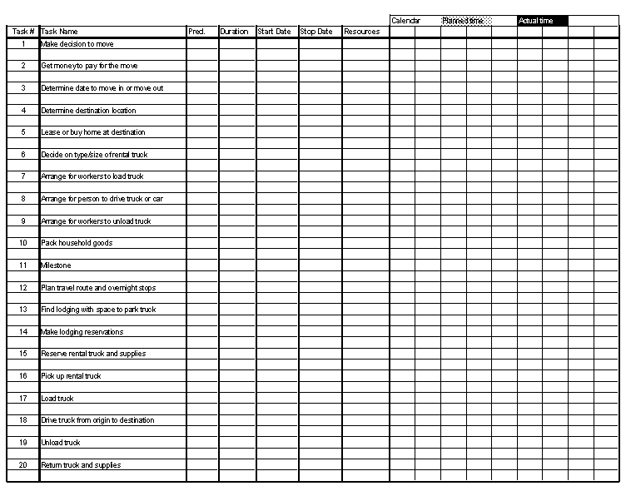
Timeline Chart for Long Distance Move

Slide 50
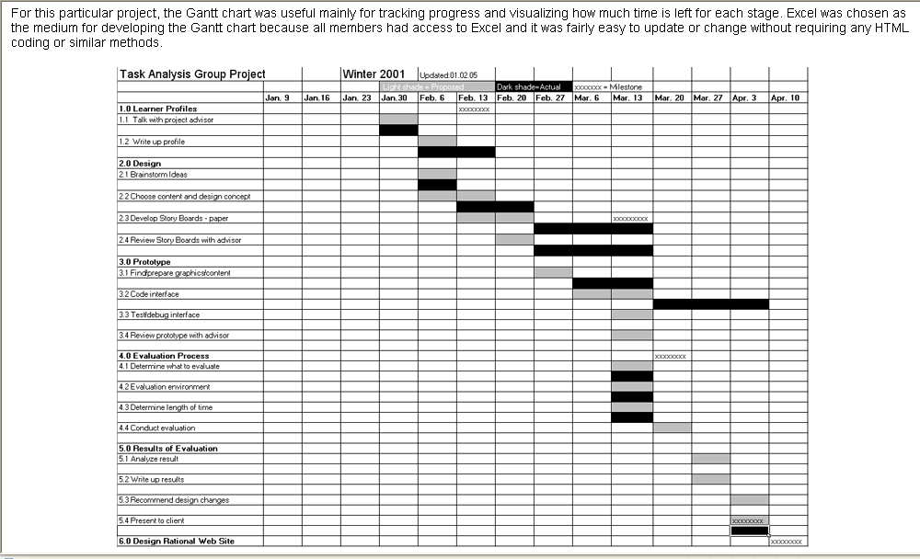
Example Timeline Chart

Slide 51
Methods for Tracking the Schedule
Qualitative approaches
  Conduct periodic project status meetings in which each team member reports progress and problems
  Evaluate the results of all reviews conducted throughout the software engineering process
  Determine whether formal project milestones (i.e., diamonds) have been accomplished by the scheduled date
  Compare actual start date to planned start date for each project task listed in the timeline chart
  Meet informally with the software engineering team to obtain their subjective assessment of progress to date and problems on the horizon
Quantitative approach
  Use earned value analysis to assess progress quantitatively
“The basic rule of software status reporting can be summarized
in a single phrase: No surprises.” Capers Jones

Slide 52
Project Control and Time Boxing
The project manager applies control to administer project resources, cope with problems, and direct project staff
If things are going well (i.e., schedule, budget, progress, milestones) then control should be light
When problems occur, the project manager must apply tight control to reconcile the problems as quickly as possible. For example:
  Staff may be redeployed
  The project schedule may be redefined
Severe deadline pressure may require the use of time boxing
  An incremental software process is applied to the project
  The tasks associated with each increment are “time-boxed” (i.e., given a specific start and stop time) by working backward from the delivery date
  The project is not allowed to get “stuck” on a task
  When the work on a task hits the stop time of its box, then work ceases on that task and the next task begins
  This approach succeeds based on the premise that when the time-box boundary is encountered, it is likely that 90% of the work is complete
  The remaining 10% of the work can be
    Delayed until the next increment
    Completed later if required

Slide 53
Milestones for OO Projects
Task parallelism in object-oriented projects makes project tracking more difficult to do than non-OO projects because a number of different activities can be happening at once
Sample milestones
  Object-oriented analysis completed
  Object-oriented design completed
  Object-oriented coding completed
  Object-oriented testing completed
Because the object-oriented process is an iterative process, each of these milestones may be revisited as different increments are delivered to the customer

Slide 54
Earned Value Analysis

Slide 55
Description of Earned Value Analysis
Earned value analysis is a measure of progress by assessing the percent of completeness for a project
It gives accurate and reliable readings of performance very early into a project
It provides a common value scale (i.e., time) for every project task, regardless of the type of work being performed
The total hours to do the whole project are estimated, and every task is given an earned value based on its estimated percentage of the total

Slide 56
Determining Earned Value
Compute the budgeted cost of work scheduled (BCWS) for each work task i in the schedule
  The BCWS is the effort planned; work is estimated in person-hours or person-days for each task
  To determine progress at a given point along the project schedule, the value of BCWS is the sum of the BCWS_{i} values of all the work tasks that should have been completed by that point of time in the project schedule
Sum up the BCWS values for all work tasks to derive the budget at completion (BAC)‏
Compute the value for the budgeted cost of work performed (BCWP)‏
  BCWP is the sum of the BCWS values for all work tasks that have actually been completed by a point of time on the project schedule

Slide 57
Progress Indicators provided through Earned Value Analysis
SPI = BCWP/BCWS
  Schedule performance index (SPI) is an indication of the efficiency with which the project is utilizing scheduled resources
  SPI close to 1.0 indicates efficient execution of the project schedule
SV = BCWP – BCWS
  Schedule variance (SV) is an absolute indication of variance from the planned schedule
PSFC = BCWS/BAC
  Percent scheduled for completion (PSFC) provides an indication of the percentage of work that should have been completed by time t
PC = BCWP/BAC
  Percent complete (PC) provides a quantitative indication of the percent of work that has been completed at a given point in time t
ACWP = sum of BCWP as of time t
  Actual cost of work performed (ASWP) includes all tasks that have been completed by a point in time t on the project schedule
CPI = BCWP/ACWP
  A cost performance index (CPI) close to 1.0 provides a strong indication that the project is within its defined budget
CV = BCWP – ACWP
  The cost variance is an absolute indication of cost savings (against planned costs) or shortfall at a particular stage of a project
☺

